Slide 1

Python
Batteries Included…

Slide 2

@pro_cessor
Twitter

Slide 3
http://cessor.de
Page

Slide 4
I ♥ Code
don’t you?

Slide 5
I ♥ PYTHON
I would f*** marry it if I could.

Slide 6
Python
is awesome!

Slide 7


Slide 8
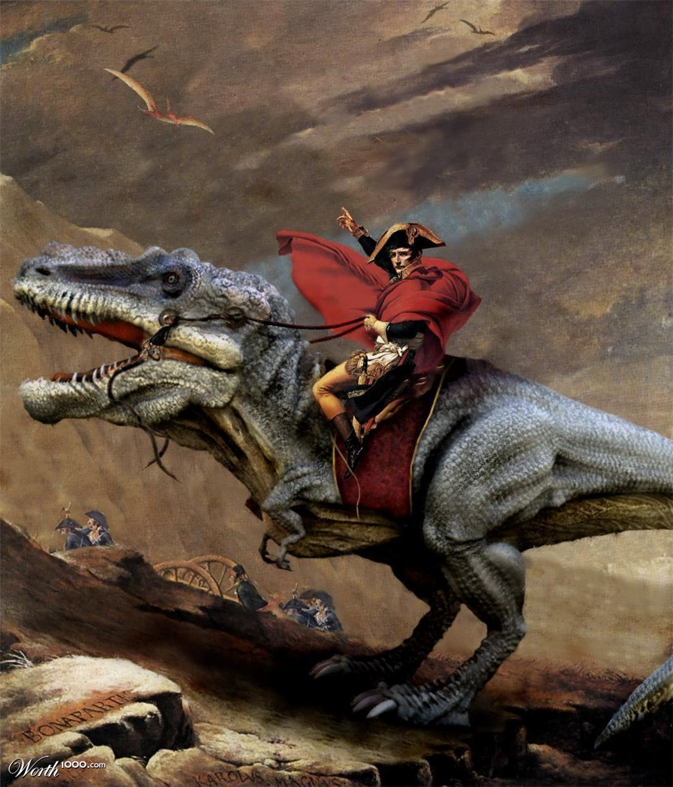

Slide 9
Red Bull
…verleiht Flügel…

Slide 10
Python
…gibt dir…

Slide 11
Python
…gibt dir…

Slide 12


Slide 13
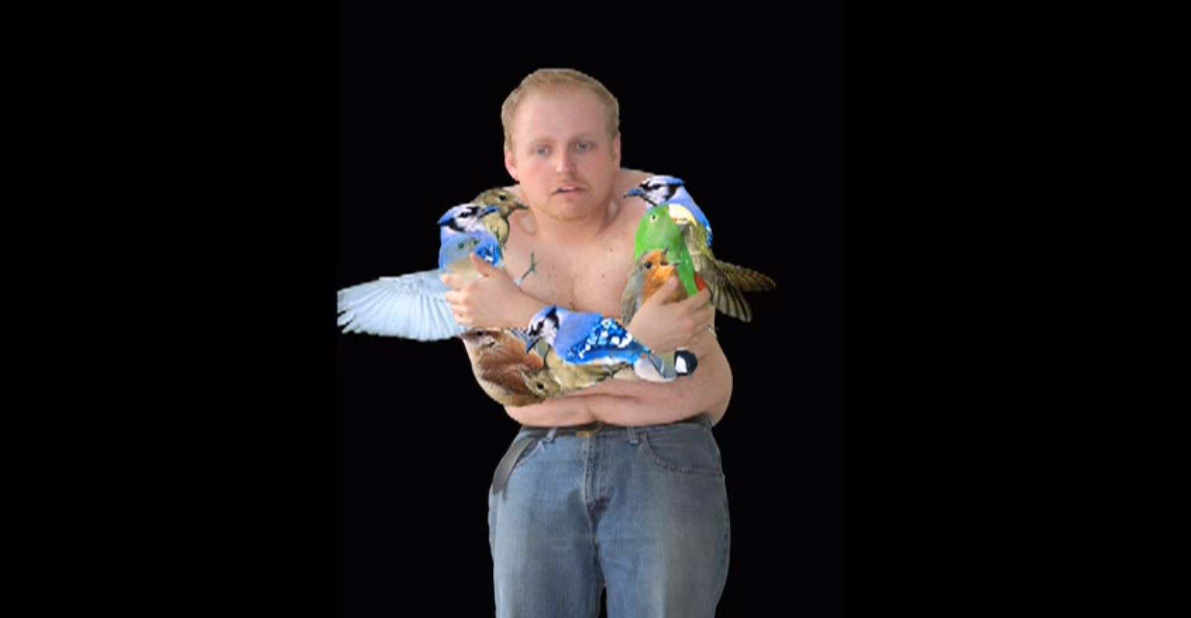

Slide 14
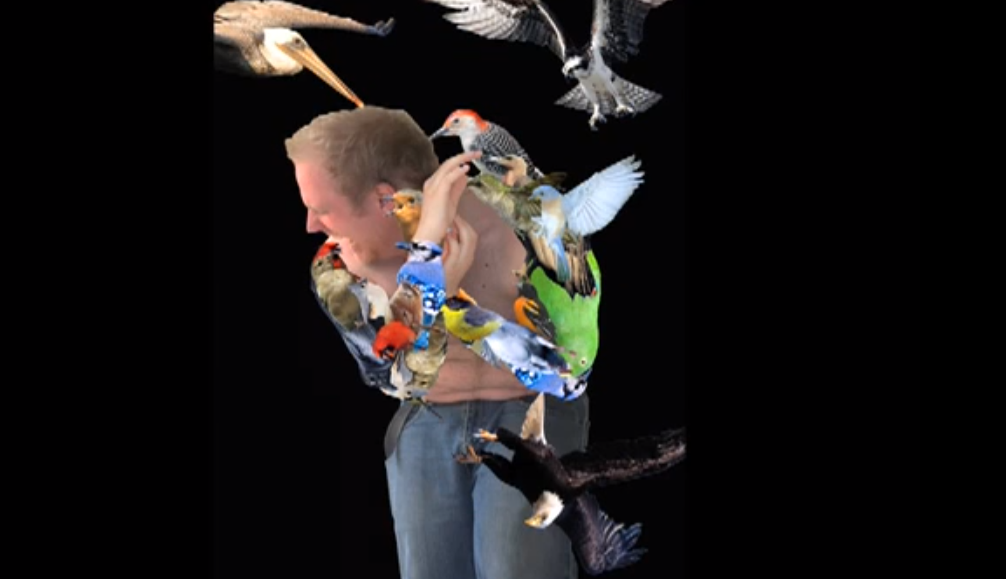

Slide 15
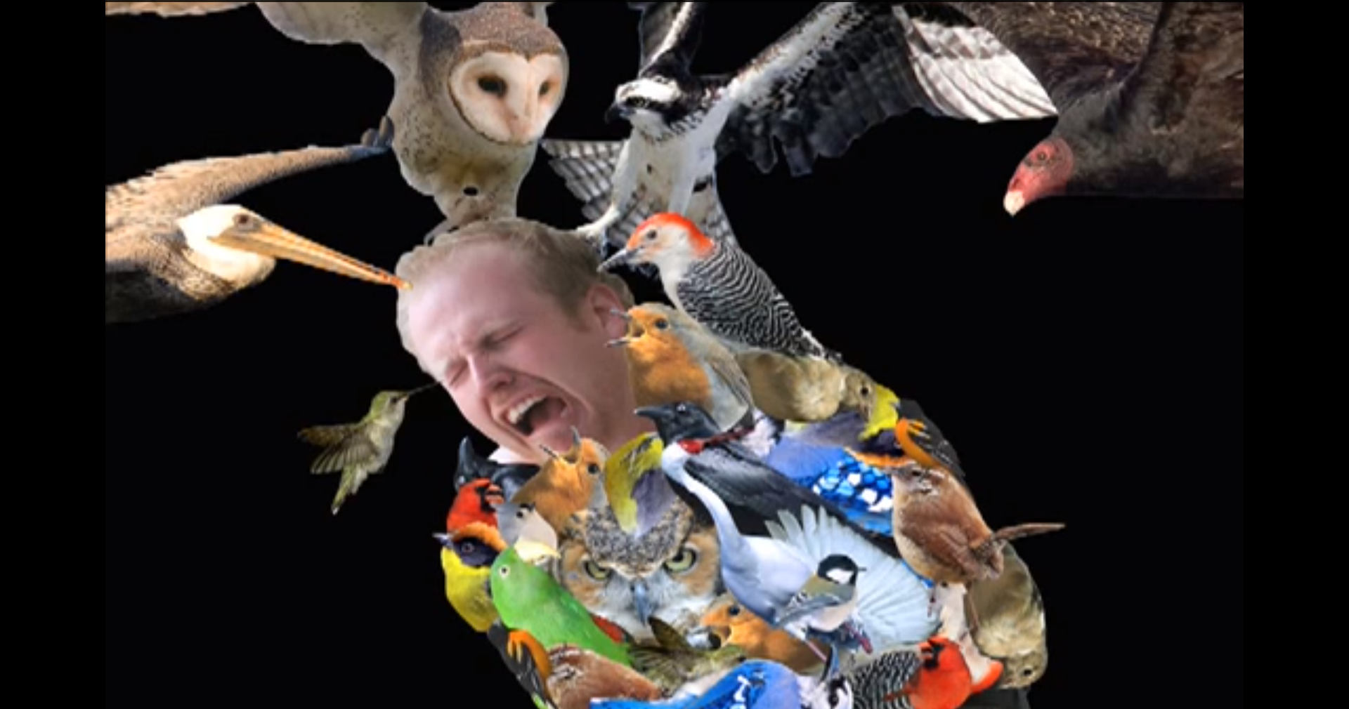

Slide 16
Duck duck = new Duck();

Slide 17
var duck = new Duck();

Slide 18
duck = Duck()

Slide 19
x = 5

Slide 20
int x = 5;

Slide 21
C# Keywords
abstract
as
base
bool
break
byte
case
catch
char
checked
class
const
continue
decimal
default
delegate
do
double
else
enum
event
explicit
extern
false
finally
fixed
float
for
foreach
goto
if
implicit
in
int
interface
internal
is
lock
long
namespace
new
null
object
operator
out
override
params
private
protected
public
readonly
ref
return
sbyte
sealed
short
sizeof
stackalloc
static
string
struct
switch
this
throw
true
try
typeof
uint
ulong
unchecked
unsafe
ushort
using
virtual
void
volatile
while

Slide 22
Python Keywords
and
as
assert
break
class
continue
def
del
elif
else
except
exec
finally
for
from
global
if
import
in
is
lambda
not
or
pass
print
raise
return
try
while
with
yield

Slide 23
DaTA TYPES
Powerful
built in!
Notes:
Your last lecture in algorithms and data structures might have been a while ago, so here is a tiny freshup

Slide 24
TUPLEs
Tiny immutable lists!
Notes:
Your last lecture in algorithms and data structures might have been a while ago, so here is a tiny freshup

Slide 25
>>> x = 1,2
>>> x
(1, 2)
>>>

Slide 26
multiple
Awesome!
return values!
Notes:
Your last lecture in algorithms and data structures might have been a while ago, so here is a tiny freshup

Slide 27
Lists
Notes:
Your last lecture in algorithms and data structures might have been a while ago, so here is a tiny freshup

Slide 28
>>> x = [1,2,3,4,5,6,7,]
>>> x
[1, 2, 3, 4, 5, 6, 7]
>>>

Slide 29
SLicing
Notes:
Your last lecture in algorithms and data structures might have been a while ago, so here is a tiny freshup

Slide 30
>>> x = [1,2,3,4,5,6,7,]
>>> x[0]
1

Slide 31
>>> x[-1]

Slide 32
>>> x = range(10)
>>> x
[0,1,2,3,4,5,6,7,8,9]
>>> x[:5]
[0,1,2,3,4]
>>> x[5]
[5,6,7,8,9]

Slide 33
>>> x = range(10)
>>> x
[0,1,2,3,4,5,6,7,8,9]
>>> x[::2]
[0,2,4,6,8]
>>> x[::-1]
[9,8,7,6,5,4,3,2,1,0]

Slide 34
>>> x[min:max:step]

Slide 35
ITERATABLE
Actually, not a list but
Iterate anything!
Notes:
Your last lecture in algorithms and data structures might have been a while ago, so here is a tiny freshup

Slide 36
>>> str = “Hello”
>>> for c in str:
... print c
H
e
l
l
o

Slide 37
>>> len(open('ls.py').read().split('\n'))

Slide 38
>>> for line in open(filename):
... print line

Slide 39
var file = new StreamReader("c:\\test.txt");
while((line = file.ReadLine()) != null)
{
Console.WriteLine (line);
}
file.Close();

Slide 40
using(var file = new StreamReader("c:\\test.txt"))
{
while((line = file.ReadLine()) != null)
{
Console.WriteLine(line);
}
}

Slide 41
with open("c:\\test.txt") as file:
for line in file:
print line

Slide 42
Who cares?

Slide 43
DICTIONARIES

Slide 44
Dictionary<string, int> romanNumerals = new Dictionary<string, int>
{
{"I", 1},
{"V", 5},
};

Slide 45
roman_numerals = {
"I": 1,
"V": 5,
}

Slide 46
var names = new List<string>
{
"Johannes","Johannes",
"Golo","Tilman","Carsten"
};
var unique_names = new HashSet<string>(names);

Slide 47
names = [
"Johannes", "Johannes",
"Golo", "Tilman“, "Carsten"
]
unique_names = set(names)

Slide 48
Logic

Slide 49
>>> True
True
>>> False
False

Slide 50
>>> True and False
False
>>> True or False
True
>>> not True
False

Slide 51
Truthy

Slide 52
>>> if not []: print “List is empty”
>>> if not None: print “Nothing”
>>> if not “”: print “Empty String”
>>> if not 0: print “Zero”

Slide 53
>>> if not [1]: print “Yes”
>>> if “ ”: print “A string”
>>> if 1: print “One”

Slide 54
If / Else

Slide 55
for i in range(100):
if i % 3 == 0:
print “fizz”,
elif i % 5 == 0:
print “buzz”
elif i % 5 == 0 and i % 3 == 0:
print “fizzbuzz”
else:
print i

Slide 56
Switch/Case
There is no
statement!

Slide 57
dictionary
Instead, use a
with functions!

Slide 58
import random
print "10 chances to find secret no."
secret = random.randint(0,1000)
for i in range(10):
x = input("> ")
if x == secret:
print "You won"
exit()
if x < secret:
print "Guess higher!"
if x > secret:
print "Guess lower!"
print "You lose. The number was", secret

Slide 59
import random
print "10 chances to find secret no."
secret = random.randint(0,1000)
for i in range(10):
x = input("> ")
if x == secret:
print "You won"
exit()
if x < secret:
print "Guess higher!"
if x > secret:
print "Guess lower!"
print "You lose. The number was", secret

Slide 60
import random
print "10 chances to find secret no."
secret = random.randint(0,1000)
messages = {
0: "You won",
1: "Guess lower!",
-1: "Guess higher!",
}
for i in range(10):
x = input("> ")
print messages[cmp(x,secret)]
print "You lose. The number was", secret

Slide 61
Constructs
Awesome

Slide 62
COALESCING
NULL
Operator ( ?? )

Slide 63
connection = connection or connect()

Slide 64
Ternary
Operator (exp?True:False)

Slide 65
("No", "Yes")[True]

Slide 66
def render_customers_available(customers):
how_many = len(customers)
plural_s = ("", "s“)[how_many > 1]
return "Customer%s" % plural_s

Slide 67
def render_customers_available(customers):
how_many = len(customers)
plural_s = ("", "s")[how_many > 1]
return "Customer%s" % plural_s

Slide 68
("Yes" if True else "No")

Slide 69
Loops

Slide 70
for(int i = 0; i < 1000; i++) ;

Slide 71
for i in range(1000):
pass

Slide 72
var evenNumbers = new List<int>();
for(int i = 0; i < 1000; i++)
{
if(i % 2 == 0)
{
evenNumbers.Add(i)
}
}

Slide 73
evenNumbers = []
for i in range(1000):
if i % 2 == 0:
evenNumbers.append(i)

Slide 74
var evens = Enumerable
.Range(0, 1000)
.Where(i => i % 2 == 0);

Slide 75
var evens =
from i in Enumerable.Range(0, 1000)
where i % 2 == 0
select i;

Slide 76
evens = [i for i in range(1000) if i % 2 == 0]

Slide 77
evens = range(1000)[::2]

Slide 78
Who Cares?
Again…

Slide 79
def quicksort(array):
if len(array) <= 1:
return array
pivot = array.pop()
left = [l for l in array if l < pivot]
right = [r for r in array if r >= pivot]
return quickSort(left, step) + [pivot] + quickSort(right, step)

Slide 80
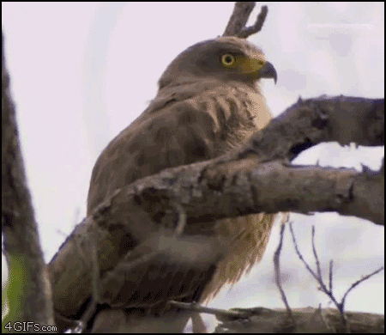

Slide 81
Functions
Beautiful
Functions are objects!
Notes:
Your last lecture in algorithms and data structures might have been a while ago, so here is a tiny freshup

Slide 82
def hello(name):
print "Hello", name

Slide 83
def hello(name):
print "Hello", name
>>> hello
<function hello at 0x0000000001EBEAC8>

Slide 84
>>> hello.t = 5

Slide 85
Que?
Notes:
Your last lecture in algorithms and data structures might have been a while ago, so here is a tiny freshup

Slide 86
>>> hello.enabled = True
>>> if hello.enabled: hello()

Slide 87
STACK
Let’s build a
so that you can see some code!
Notes:
Your last lecture in algorithms and data structures might have been a while ago, so here is a tiny freshup

Slide 88
1

Slide 89
2
1

Slide 90
3
2
1

Slide 91
Notes:
Let’s take a box

Slide 92
Notes:
Let’s take a box

Slide 93
1
Notes:
Let’s take a box

Slide 94
1
Notes:
Let’s take a box

Slide 95
1
2
Notes:
Let’s take a box

Slide 96
1
2
3
Notes:
Let’s take a box

Slide 97
public class Stack<TArg>
{
private Node _head;
private class Node
{
public TArg Value { get; set; }
public Node Next { get; set; }
}
public void Push(TArg value)
{
_head = new Node { Value = value, Next = _head};
}
public TArg Pop()
{
if(IsEmpty()) return default(TArg);
TArg item = _head.Value;
_head = _head.Next;
return item;
}
public bool IsEmpty()
{
return _head == null;
}
}

Slide 98
class Stack<TArg>
{
Node _head;
class Node
{
TArg Value { get; set; }
Node Next { get; set; }
}
void Push(TArg value)
{
_head = new Node { Value = value, Next = _head};
}
TArg Pop()
{
if(IsEmpty()) return default(TArg);
TArg item = _head.Value;
_head = _head.Next;
return item;
}
bool IsEmpty()
{
return _head == null;
}
}

Slide 99
class Stack<TArg>
{
Node _head;
class Node
{
TArg Value { get; set; }
Node Next { get; set; }
}
def Push(TArg value)
{
_head = new Node { Value = value, Next = _head};
}
def Pop()
{
if(IsEmpty()) return default(TArg);
TArg item = _head.Value;
_head = _head.Next;
return item;
}
def IsEmpty()
{
return _head == null;
}
}

Slide 100
class Stack<TArg>
{
Node _head;
class Node
{
TArg Value { get; set; }
Node Next { get; set; }
}
def Push(TArg value)
{
_head = new Node { Value = value, Next = _head};
}
def Pop()
{
if(IsEmpty()) return default(TArg);
TArg item = _head.Value;
_head = _head.Next;
return item;
}
def IsEmpty()
{
return _head == null;
}
}

Slide 101
class Stack
{
Node _head;
class Node
{
Value { get; set; }
Next { get; set; }
}
def Push(value)
{
_head = new Node { Value = value, Next = _head};
}
def Pop()
{
if(IsEmpty()) return None;
item = _head.Value;
_head = _head.Next;
return item;
}
def IsEmpty()
{
return _head == null;
}
}

Slide 102
class Stack
{
Node _head
class Node
{
Value { get set }
Next { get set }
}
def Push(value)
{
_head = new Node { Value = value, Next = _head}
}
def Pop()
{
if(IsEmpty()) return None
item = _head.Value
_head = _head.Next
return item
}
def IsEmpty()
{
return _head == null
}
}

Slide 103
class Stack
{
Node _head
class Node
{
Value { get set }
Next { get set }
}
def Push(value)
{
_head = new Node { Value = value, Next = _head}
}
def Pop()
{
if(IsEmpty()) return None
item = _head.Value
_head = _head.Next
return item
}
def IsEmpty()
{
return _head == null
}
}

Slide 104
class Stack
Node _head
class Node
Value get set
Next get set
def Push(value)
_head = new Node
Value = value, Next = _head
def Pop()
if(IsEmpty()) return None
item = _head.Value
_head = _head.Next
return item
def IsEmpty()
return _head == null

Slide 105
class Stack:
Node _head
class Node
Value get set
Next get set
def Push(value):
_head = new Node
Value = value, Next = _head
def Pop():
if(IsEmpty()) return None
item = _head.Value
_head = _head.Next
return item
def IsEmpty():
return _head == null

Slide 106
class Stack:
Node _head
class Node
Value get set
Next get set
def Push(value):
_head = new Node
Value = value, Next = _head
def Pop():
if(IsEmpty()) return None
item = _head.Value
_head = _head.Next
return item
def IsEmpty():
return _head == null

Slide 107
class Stack:
_head = None
def Push(value):
_head = (value, _head)
def Pop():
if(IsEmpty()) return None
item, _head = _head
return item
def IsEmpty():
return _head == null

Slide 108
class Stack:
_head = None
def Push(value):
_head = (value, _head)
def Pop():
if(IsEmpty()) return None
item, _head = _head
return item
def IsEmpty():
return _head == null

Slide 109
class Stack:
_head = None
def Push(value):
_head = (value, _head)
def Pop():
if IsEmpty(): return None
item, _head = _head
return item
def IsEmpty():
return _head == null

Slide 110
class Stack:
_head = None
def Push(self, value):
self.head = (value, self.head)
def Pop(self):
if IsEmpty(): return None
item, self.head = self.head
return item
def IsEmpty(self):
return self.head == null

Slide 111
class Stack(object):
def __init__(self):
self.head = None
def push(self, value):
self.head = (value, self.head)
def pop(self):
if self.is_empty(): return None
value,self.head = self.head
return value
def is_empty(self):
return self.head == None

Slide 112
class Stack(object):
def __init__(self):
self.head = None
def push(self, value):
self.head = (value, self.head)
def pop(self):
if self.is_empty(): return None
value,self.head = self.head
return value
def is_empty(self):
return self.head == None
public class Stack<TArg>
{
private Node _head;
private class Node
{
public TArg Value { get; set; }
public Node Next { get; set; }
}
public void Push(TArg value)
{
_head = new Node { Value = value, Next = _head};
}
public TArg Pop()
{
if(IsEmpty()) return default(TArg);
TArg item = _head.Value;
_head = _head.Next;
return item;
}
public bool IsEmpty()
{
return _head == null;
}
}

Slide 113
Whitespace
Sensitivity to
Lose the { } ;

Slide 114
Dynamic
The language is
And so are the types

Slide 115
Data Structures
Powerful
Built in…

Slide 116
SELF POINTER
Explicit
Aka ‘this’

Slide 117
Why is that?

Slide 118
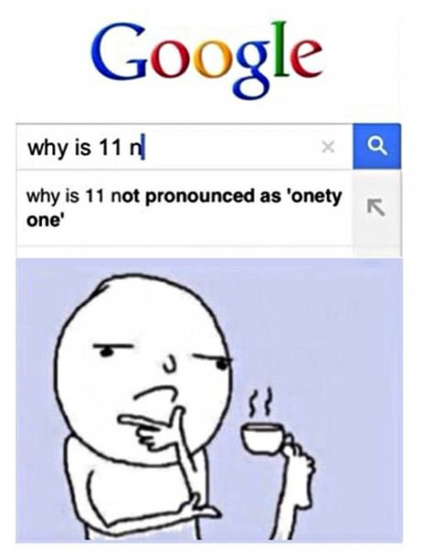

Slide 119
>>> IMPORT THIS

Slide 120
Beautiful is better than ugly.
Explicit is better than implicit.
Simple is better than complex.
Complex is better than complicated.
Flat is better than nested.
Sparse is better than dense.
Readability counts.

Slide 121
Beautiful is better than ugly.
Explicit is better than implicit.
Simple is better than complex.
Complex is better than complicated.
Flat is better than nested.
Sparse is better than dense.
Readability counts.

Slide 122
Linq…
…as stolen from Haskell

Slide 123
>>> [i for i in range(10) if i % 2 == 0]
[0, 2, 4, 6, 8]

Slide 124
>>> [i for i in range(10) if i % 2 == 0]
[0, 2, 4, 6, 8]

Slide 125
>>> [i for i in range(10) if i % 2 == 0]
[0, 2, 4, 6, 8]
Select
From
Where

Slide 126
>>> (i for i in range(10) if i % 2 == 0)
<generator object <genexpr> at 0x000001E4EF78>

Slide 127
def surveyForFilesIn(directory):
survey = (
signature(root, file)
for root,dirs,files in os.walk(directory)
for file in files
if containsCode(file)
and not useless(file)
)
return survey

Slide 128
DynAmic…

Slide 129
def wrap(function):
def decorate(*args,**kwargs):
print 'Before'
result = function(*args,**kwargs)
print 'After'
return result
return decorate

Slide 130
def wrap(function):
def decorate(*args,**kwargs):
print 'Before'
result = function(*args,**kwargs)
print 'After'
return result
return decorate
def increment(i):
return i + 1
increment = wrap(increment)

Slide 131
>>> def increment(i):
... return i + 1
>>> increment(10)
11

Slide 132
>>> def increment(i):
... return i + 1
>>> increment(10)
11
>>> increment = wrap(increment)
>>> increment(12)
Before
13
After
>>>

Slide 133
import sys
def log(function):
def decorate(*args, **kwargs):
if sys.flags.debug:
print function.__name__, args
return function(*args, **kwargs)
return decorate
def increment(i):
return i + 1
increment = log(increment)
print increment(99)

Slide 134
import sys
def log(function):
def decorate(*args, **kwargs):
if sys.flags.debug:
print function.__name__, args
return function(*args, **kwargs)
return decorate
def increment(i):
return i + 1
increment = log(increment)
print increment(99)

Slide 135
$ python increment.py
100
$

Slide 136
$ python –d increment.py
increment (99,)
100
$

Slide 137
import sys
def log(function):
def decorate(*args, **kwargs):
if sys.flags.debug:
print function.__name__, args
return function(*args, **kwargs)
return decorate
def increment(i):
return i + 1
increment = log(increment)
print increment(99)

Slide 138
import sys
def log(function):
def decorate(*args, **kwargs):
if sys.flags.debug:
print function.__name__, args
return function(*args, **kwargs)
return decorate
@log
def increment(i):
return i + 1
print increment(99)

Slide 139
DECORATORS!
Ba-bam!
For free! F**k yeah!

Slide 140

MAGIC

Slide 141

Import ANTIGRAVITY
http://xkcd.com/353/

Slide 142
Libraries
Some are nice…
…some aren’t

Slide 143
$ python -m SimpleHTTPServer
Serving HTTP on 0.0.0.0 port 8000 ...

Slide 144
FILE SHARING
Ba-bam!
For free! F**k yeah!

Slide 145
import urllib2
github = 'https://api.github.com'
req = urllib2.Request(github)
password_manager = urllib2.HTTPPasswordMgrWithDefaultRealm()
password_manager.add_password(None, github, 'user', 'pass')
auth_manager = urllib2.HTTPBasicAuthHandler(password_manager)
opener = urllib2.build_opener(auth_manager)
urllib2.install_opener(opener)
handler = urllib2.urlopen(req)
print handler.getcode()
print handler.headers.getheader('content-type')

Slide 146
import requests
github = 'https://api.github.com'
response = requests.get(github, auth=('user', 'pass'))
print response.status_code
print response.headers['content-type']

Slide 147
WEB CRAWLING
Ba-bam!
For free! F**k yeah!

Slide 148

from flask import Flask
app = Flask(__name__)
@app.route("/")
def hello():
return "Hello World!"
if __name__ == "__main__":
app.run()

Slide 149
WEB SERVER
Ba-bam!
For free! F**k yeah!

Slide 150
HEROKU
Ba-bam!
For free! F**k yeah!

Slide 151
MAGIC
But where is the
happening?

Slide 152
Unfortunately
My COMPANY
I should really have this next part in
comic sans
also bullet points
And clipart
Since it is really the
part of the presentation
I am sorry, don’t run away.
please
ugliest
Folie 67
Johannes Hofmeister
Dotnet developer conference

Slide 153
people
Seriously, why do some
really have slides like the last one?

Slide 154
Installation

Slide 155
Libs
PIP
Virtual ENV
Python

Slide 156
Python 2.7.3
Do get:
x64, if you like

Slide 157
Virtual ENVironment
Then, setup a
It’s usefull for lots of stuff

Slide 158
PACKAGE MANAGER
Then, get the
It is just like NuGet or NPM

Slide 159
PIP
This is really the hardest step…
Pip installs packages

Slide 160
$ cd /Python2.7
$ curl -O https://github.com/pypa/virtualenv/raw/master/virtualenv.py
$ python virtualenv.py default
$ ./default/bin/activate.bat
(default)$ pip install <package name>

Slide 161
$ pip freeze
BeautifulSoup==3.2.1
Django==1.4
Flask==0.8
Markdown==2.1.1
PyMySQL==0.5
PyOpenGL==3.0.2
markdown2==1.4.2
nose==1.2.1
requests==0.14.1

Slide 162
Bulletpoints
PANDAS
SciPy, Numpy
Pygame
Scrapy

Slide 163


